Slide 1

Power BI
MS Power Platform
MS Power Platform

Slide 2
Day 1: Introduction to Power BI
What is power BI.
Key features and benefits.
Understanding the Power BI ecosystem.
Installing Power BI Desktop.
Day 2: Getting Started with Power BI Desktop
Creating new report.
Importing data from various sources.
Basic data transformations.

Slide 3
Day 3: Data Modelling in Power BI
Understanding tables, relationships, and measures.
Creating calculated columns and measures.
Introduction to DAX (Data Analysis Expressions).
Day 4: Data Visualisation Basics
Introduction to visualisations.
Creating charts, tables, and metrices.
Formatting options for visuals.

Slide 4
Day 5: Intermediate Data Transformations
Data transformation using power query editor.
Merging and upending queries.
Data cleaning techniques.
Day 6: Advanced Data Modelling
Working with multiple tables and relationships.
Introduction to tax functions and advanced calculations.

Slide 5
Day 7: Customising Visuals
Using custom visuals from the marketplace.
Working with themes and colour palettes.
Interactive visualisations using drill through and drill down.
Day 8: Power BI Data Analysis Features
hierarchies and drill-downs.
Slicers and Filters.
Time intelligence functions index.

Slide 6
Day 9: Creating dashboards
Designing effective dashboards
Adding interactive elements like buttons and bookmarks
Best practises for dashboard design
Day 10: Power BI services and sharing
Uploading reports to power B I service.
Collaborating and sharing reports with others.
Creating and managing workplaces.
Introduction to row level security & Data refresh.

Slide 7

What is Business Intelligence?
Business Intelligence (BI) is a set of processes, architectures, and technologies that help in the collection, integration, analysis, and presentation of business information. The purpose of Business Intelligence is to enable stakeholders make better business decisions

Slide 8
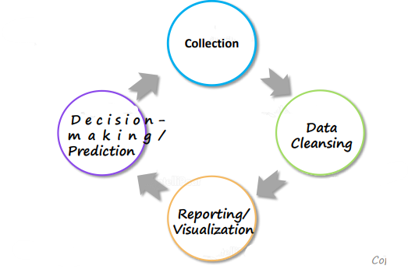
Stages of Business Intelligence
Business Intelligence is generally divided into four stages:

Slide 9
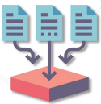



Stages of Business Intelligence
Data is collected either from the existing sources, such as ERP data, company database, etc., or externally through polls, forms, and others
Identifying irrelevant parts of the data and modifying, deleting, or replacing the coarse data
Graphical representation of data using visual elements such as charts, graphs, tables, etc.
The last stage is making business decisions and monitoring and predicting business trends based on the report developed

Slide 10

BI is everywhere!

Slide 11

BI is everywhere!
HGS makes use of BI for sales reporting and sales prediction dashboards, WFM Analytics Dashboards, Tracking Employee Productive Hours etc
Business Intelligence allows the company to make decisions at the right time
BI also allows the company to discover why its sales are dropping in a particular domain and helps it understand where it needs to perform better

Slide 12
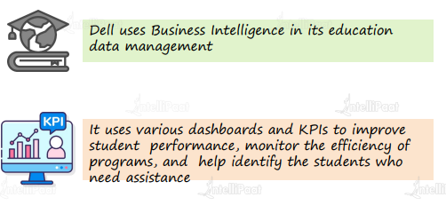
BI Use Cases

Slide 13


Slide 14
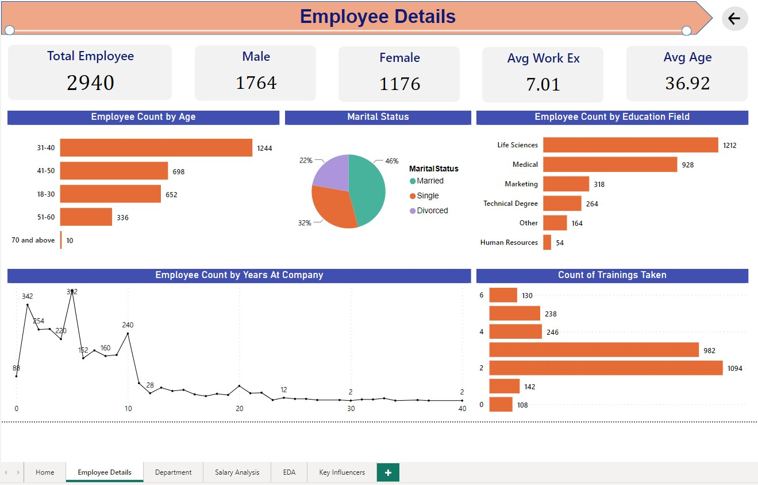

Slide 15
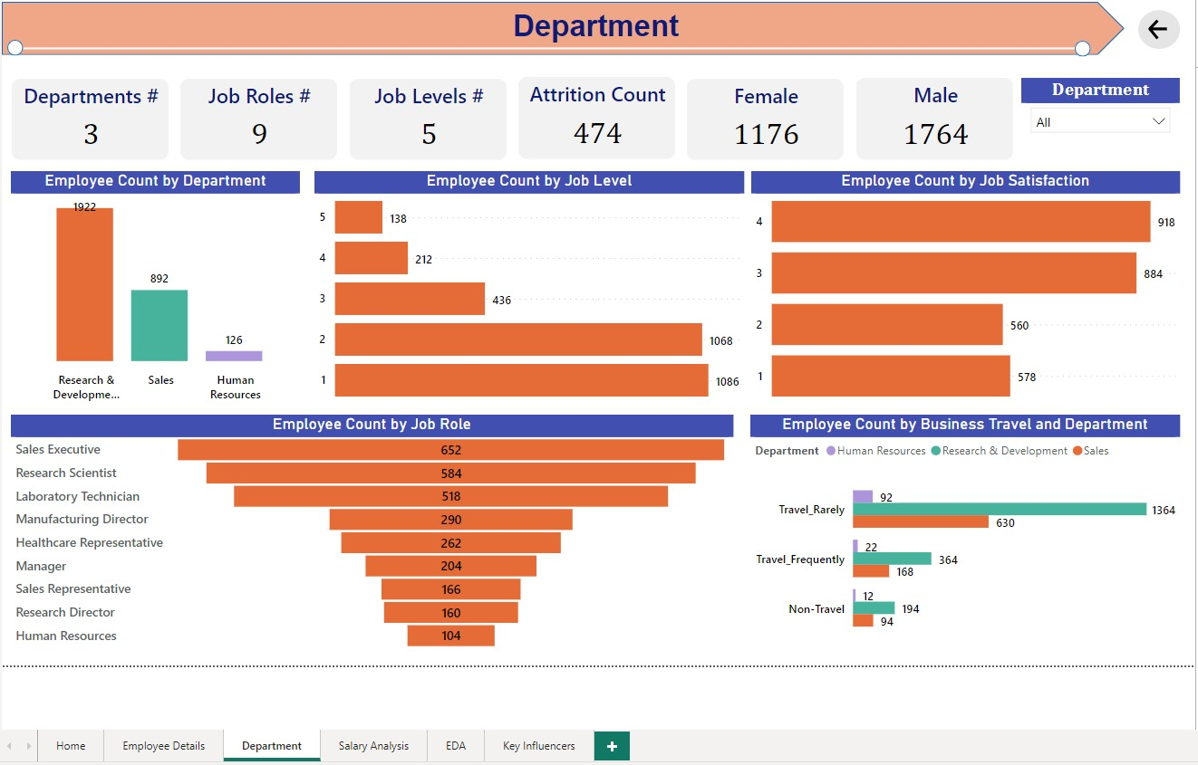

Slide 16
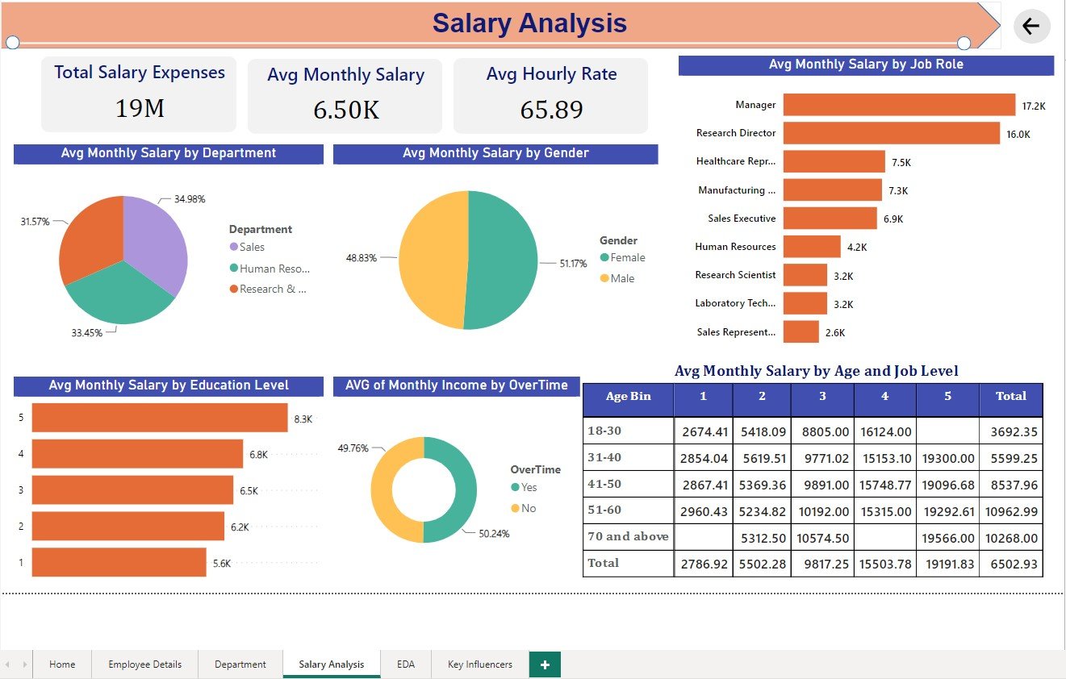

Slide 17
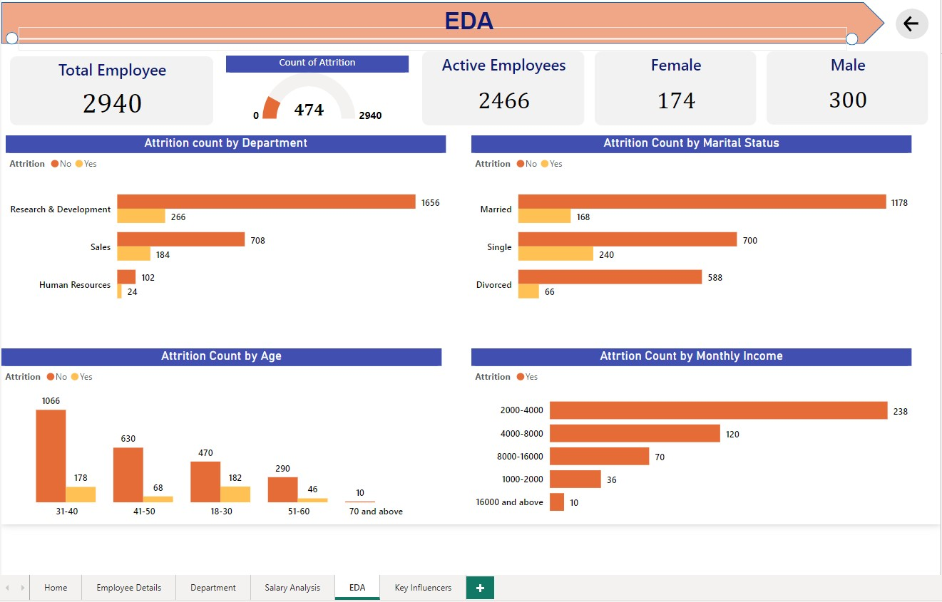

Slide 18
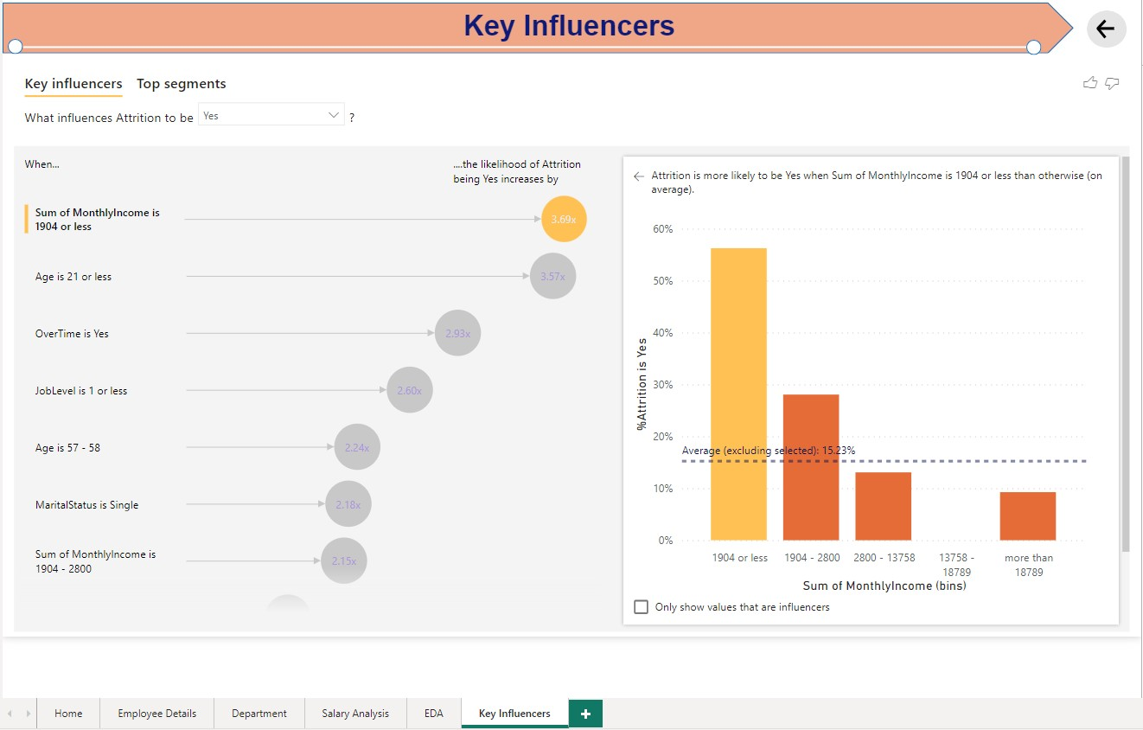

Slide 19



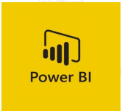
BI Tools

Slide 20
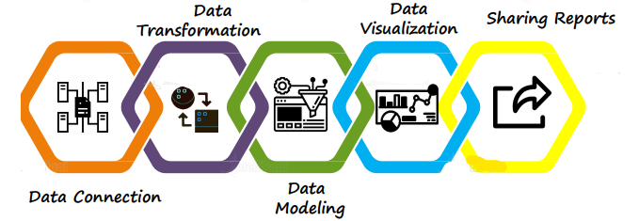
Power BI is a Business Intelligence platform, which provides tools for aggregating, analyzing, visualizing and sharing data

Slide 21






Power BI Components
PBI Gateway
Power BI Desktop
PBI Service
PBI Report Server
Power BI Report Builder
Power BI Mobile APP
Power Query
Power BI Embedde

Slide 22
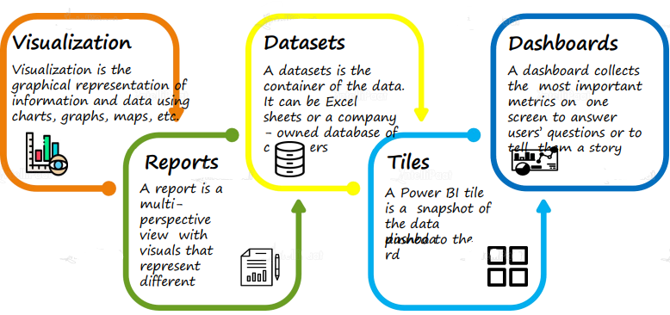
Building Blocks of Power BI

Slide 23
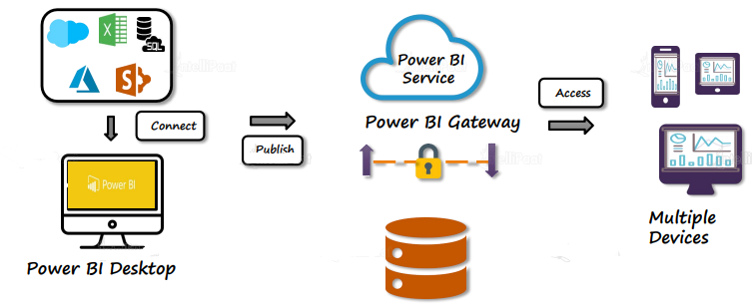
Architecture of Power BI

Slide 24
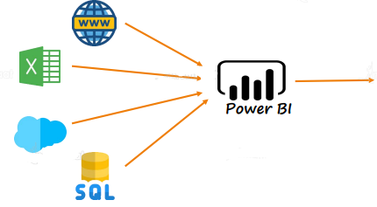
Power BI Desktop combines Microsoft Query Engine (M) with visualization and data modeling for creating interactive reports

Slide 25
Thank You

